Slide 1

THE
HIRE
BOT
Notes:
Photo by rawpixel on Unsplash

Slide 2

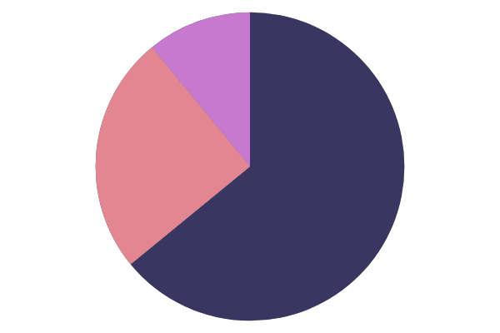
OBJECTIVES
RECRUIT FAST
RECRUIT IN LARGE NUMBERS
PROVIDE INSIGHTS

Slide 3
METHODOLOGY
Record Video
Pre Processing
Provide Insights
Recording done in web browser
Analyze Video and Speech
Provide insights like candidate traits

Slide 4

FACTORS AFFECTING RECRUITMENT
Check Confidence
Check traits
Provide concise insights

Slide 5



INSIGHTS
CONFIDENCE
ANALYTICAL
TENTATIVE

Slide 6
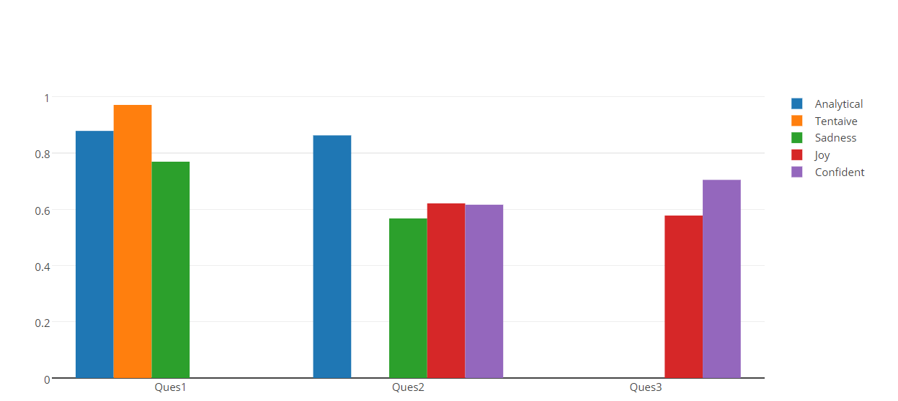

TRAITS FOR EACH QUESTION

Slide 7
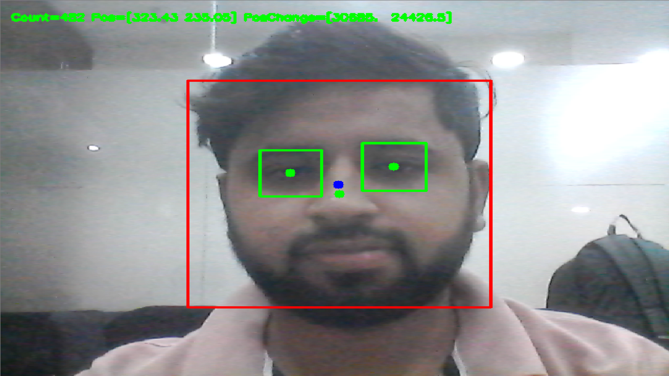
Video Analysis
Blue point is the reference point which is taken as the average of frames for a few seconds after fixed interval of time. Then the change in position of face is calculated with this reference point. Same is the case with eyes.

Slide 8
THANK YOU
Notes:
Photo by rawpixel on Unsplash

